Slide 1


Employee Churn Prediction
TSP- AI ML Fundamentals (Capstone Project)
Presented By:
D.BALAMURUGAN , NM ID - au810021114017 , REG.NO:810021114017
UNIVERSITY COLLEGE OF ENGINEERING(BIT CAMPUS),TIRUCHIRAPPALLI
Guided By:
P.RAJA MASTER TRAINER

Slide 2
OUTLINE
Problem Statement (Should not include solution)
Objective
Scope
Significance
Project Demo(video)
Conclusion
Future Scope
References
GIT hub link

Slide 3
Problem Statement
Employee churn, or employee turnover, represents the departure of employees from a company within a given period. High employee churn negatively impacts an organization’s efficiency, leading to financial losses and lower employee morale. Predicting churn can help HR departments identify potential factors influencing employee departure and implement strategies to retain valuable talent.

Slide 4
OBJECTIVE
The primary objective is to build a predictive model that can accurately identify employees likely to churn and provide insights into the key factors influencing their decisions. This model will help HR departments make data-driven decisions to minimize churn.

Slide 5
SCOPE
This study focuses on employee data from a company, which includes features like age, salary, department, job satisfaction, and promotion history. The model aims to provide actionable insights specific to the dataset and organization studied.

Slide 6
SIGNIFICANCE
Employee churn prediction is essential for companies to reduce turnover costs, retain experienced staff, and improve overall employee satisfaction. By understanding the factors driving churn, companies can create better work environments and retain top talent.

Slide 7
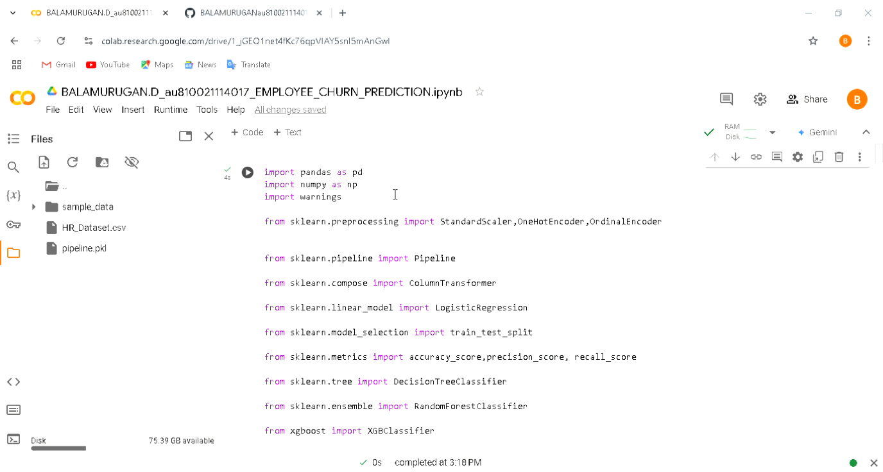
Project Demo(Recorded Video)

Slide 8
Conclusion
This project successfully developed an employee churn prediction model using machine learning techniques. The gradient boosting model provided high accuracy and identified key factors influencing churn. While effective, this project had some limitations, including data constraints and possible biases. Future research could involve more advanced techniques, larger datasets, or deep learning approaches for improved accuracy.

Slide 9
Future Scope
The future scope for employee churn prediction is broad, with advancements in technology and data science continuing to offer new possibilities for enhancing predictive models and improving employee retention strategies. Here are some key areas for future development:
1. Integration of Real-Time Data
2. Use of Advanced Machine Learning Models
3. Incorporation of Sentiment Analysis
4.Personalized Retention Strategies
5. Ethics and Fairness in Prediction Models

Slide 10
References
1. Huang, Q., & Wang, J. (2019). "A Predictive Model for Employee Churn Based on Machine Learning."
2. Nguyen, T., & Nguyen, Q. (2020). "Predicting Employee Turnover Using Machine Learning: A Case Study."
3. Raschka, S., & Mirjalili , V. (2019). Python Machine Learning (3rd Edition).
4. Khera, N., & Divya, K. (2019). "Predicting Employee Attrition with Machine Learning."
5. Garg, A., & Patel, H. (2018). "Comparative Analysis of Machine Learning Techniques for Employee Turnover Prediction."
6. Kaur, H., & Kang, V. (2021). "Employee Attrition Prediction: A Review of Machine Learning Techniques."

Slide 11
GIT hub link of Project
https://github.com/BALAMURUGANau810021114017/BALAMURUGAN.D_au810021114017_Employee_Churn_Prediction_NM_PROJECT.git

Slide 12
THANK YOU

